Slide 1




Institute: Samsenwittayalai School | Thailand
Application of Domino's Tiling Theory to calculate the probability of tatami mat arrangements in rectangular rooms, the number of mats required, and the areas where a full sheet of tatami mat cannot be arranged

Slide 2




Supervisor
Team member 1
Team member 2
Team member 3
Mr. Suthiphan Hiranpruk
Mr. Tinnapat Sittisuwan
Mr. Saran Laiwisetkun
Mr. Saknarin Srima

Slide 3
Table of contents
01
02
03
04
Introduction
The pain point of this project: Tatami tiles
Method
Process of tatami’s calculation program
Test and result
Test and result of tatami’s calculation program
Suggestion and conclusion
Conclusion and suggestion of tatami’s calculation program

Slide 4
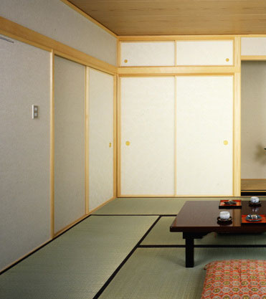
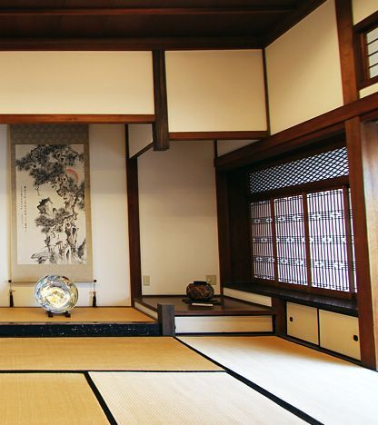

Slide 5
Introduction
Domino Tiling is the process of tiling dominoes to perfection in the square or rectangular area.
Tatami is an ancient mat of Japan used as a floor covering.
We found that the play of the dominoes resembles the process of placing Tatami mats in Japanese. Then we use the method of Domino Tiling to solve the process of placing the tatami mats.

Slide 6
Objective
the number of methods for arranging the Tatami tiles into the room size 2*n and 3*n
the total number of tiles used in the arrangement, and
the remaining room space that cannot be filled with full sheets of tatami mats

Slide 7
02
Method
Process of Tatami’s calculation programming
Notes:
So.the next one is the method.

Slide 8


Variables and formulas
Variables
Formulas
r_w (room width)
Room area formula
r_l (room length)
$$r_{area}=r_{width}×r_{length}$$
t_w (tatami width)
t_l (tatami length)
Tatami area formula
$t_{area}=t_{width}×t_{length}$

Slide 9
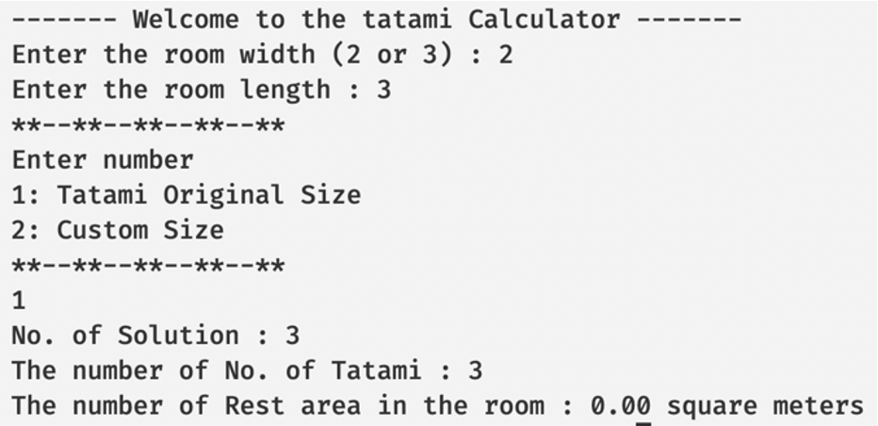
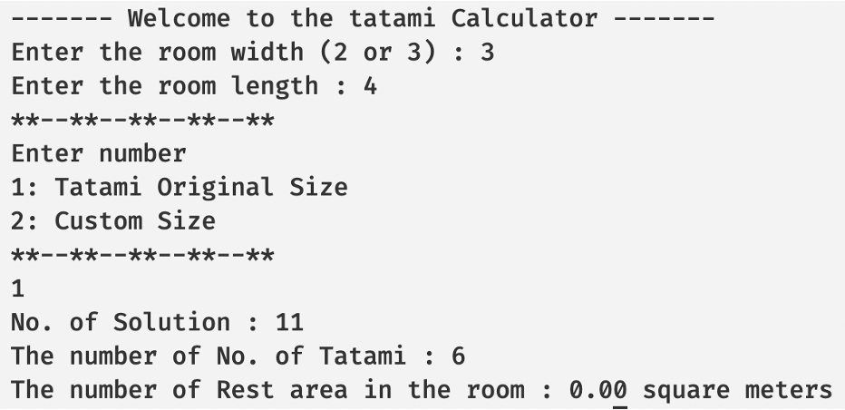
Program UI Design
Notes:
Our program's UI design focuses on ease of use.

Slide 10

Code the program
C-language
Notes:
The next one is code the program

Slide 11
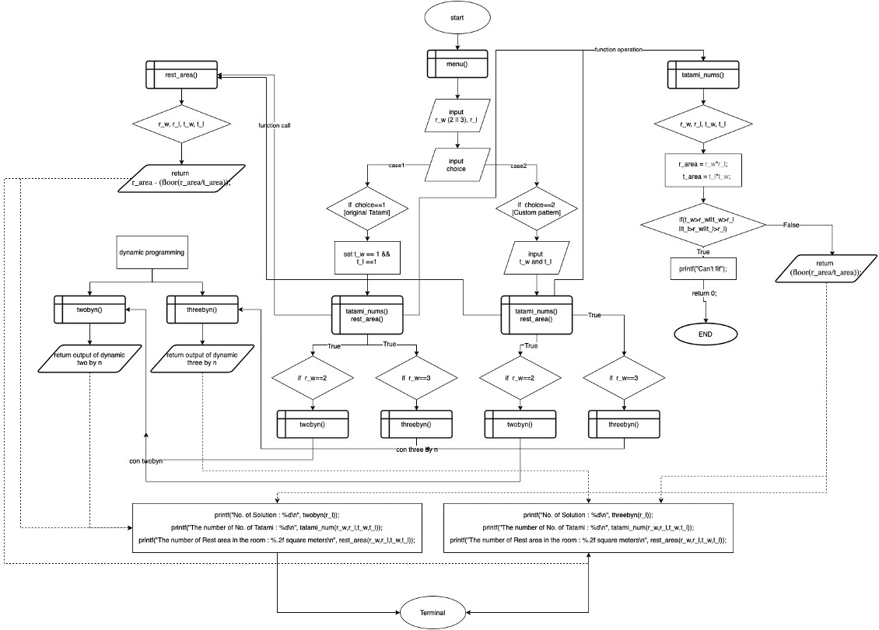
Project Flowchart
Project Flowchart
C-language program
Notes:
Before we write programs We have created a rough flowchart of programming.

Slide 12
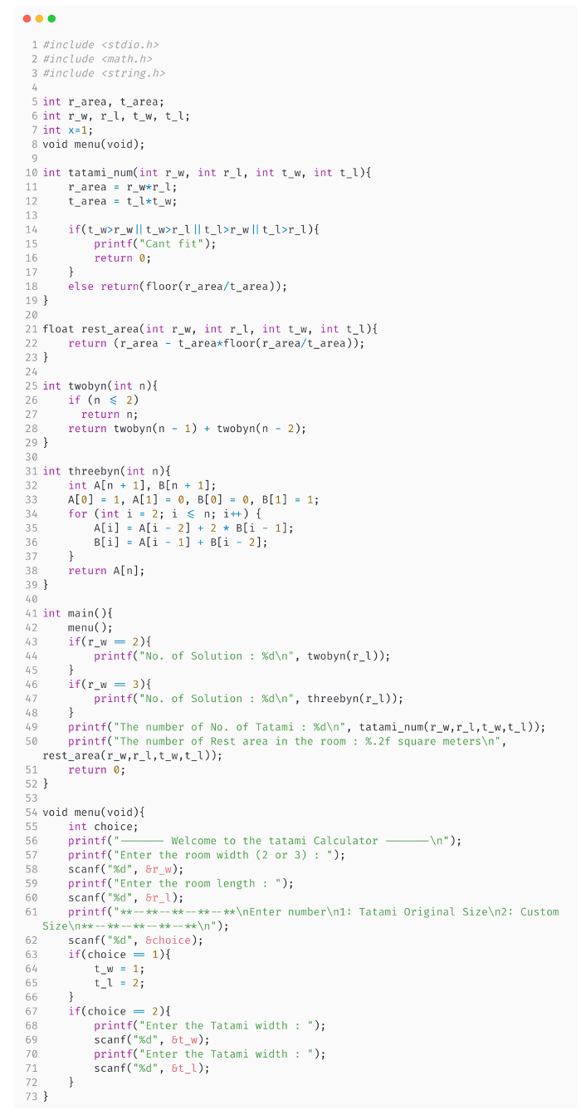
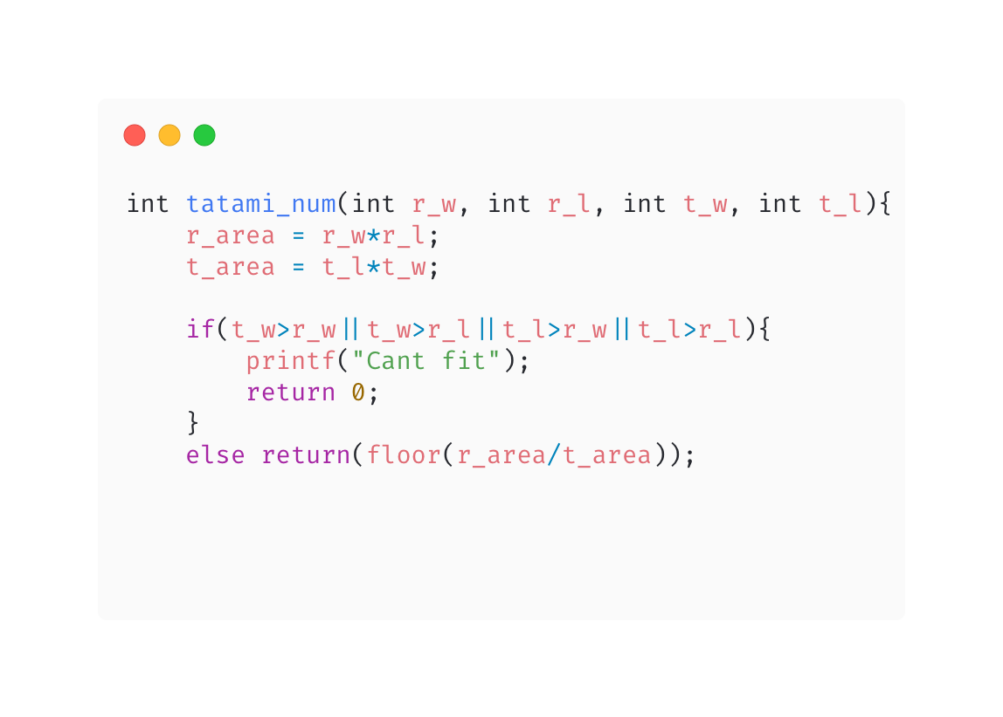
Func. tatami_num
Notes:
The first function calculates the total number of tiles that can be arranged in a room using floor function.

Slide 13
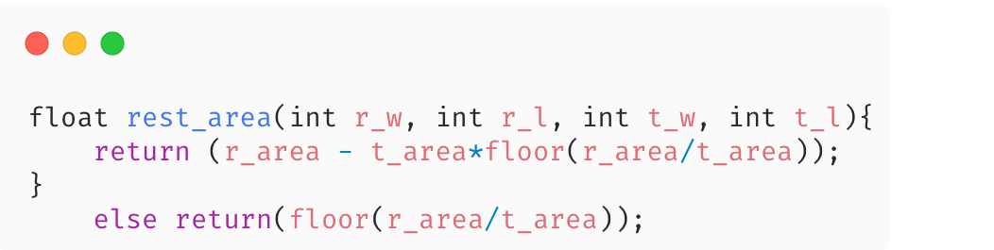
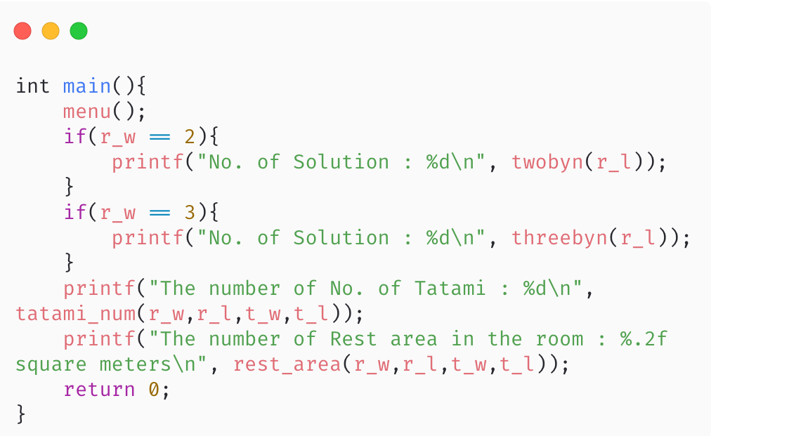
Func. rest_area
Func. main
Notes:
The second function is calculate the remainder of area after arranged the tiles in a room. And the third is main function.

Slide 14
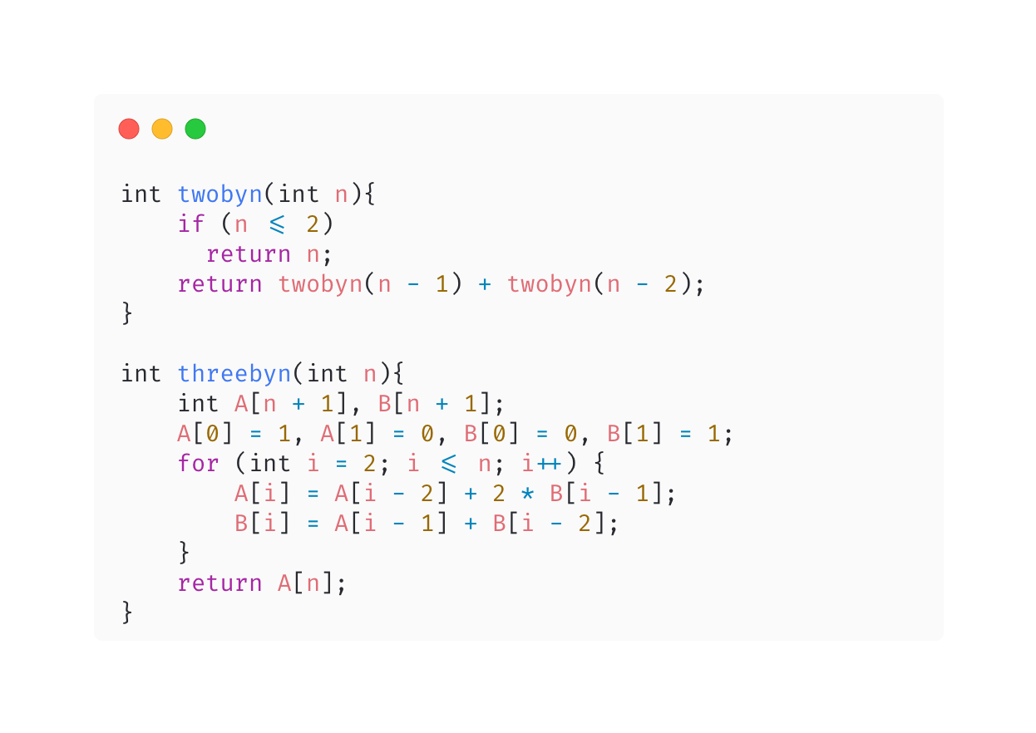
Func. 2byN and 3byN
Notes:
Last function is dynamic programming function to calculate the possible ways of 2byN and 3byN room using fibonucci and domino’s tiling theorem.

Slide 15
03
Test and result
Test and result of Tatami’s calculation programming
Notes:
The cost of arranged tiles in one room can be calculated by the number of pieces of tile.
This program can be applied in industry. Example Tiles factory
This information can be used in other research studies.
This project can be used as a model or as a case study in applying mathematics to our daily life.

Slide 16
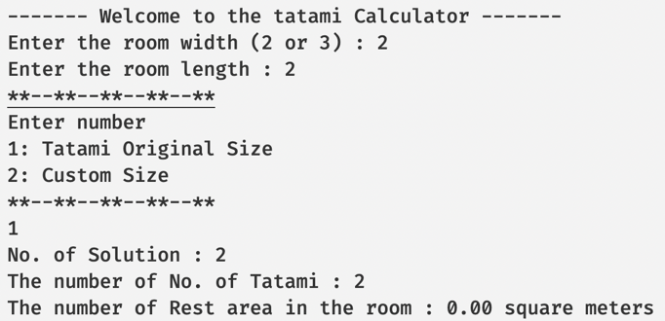
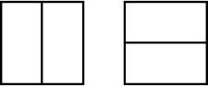

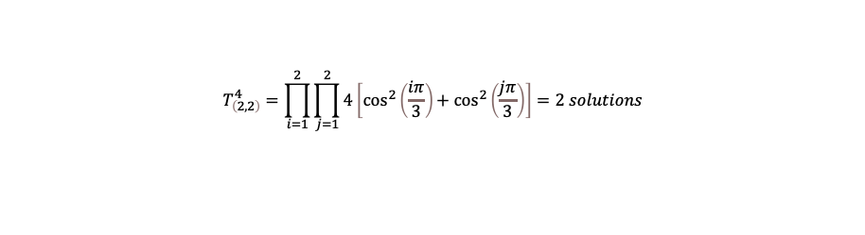
Test and result
r_w=2, r_l=2, original size
Compared the result
To compare the output from the program with the Domino tiling theorem.
To compare the output from the program with the general form of arrangement theory.
to compare the output from the program with Writing all possible cases
$A_{n}=2^{2}\left[{\left(\frac{1}{2}\right)}^{2}+{\left(\frac{1}{2}\right)}^{2}\right]$. $A_{n}=2^{2}\left[{\left(\frac{1}{2}\right)}^{2}+{\left(\frac{1}{2}\right)}^{2}\right]$ = $2^{2}\left[\frac{1}{2}\right]=2 solutions$
$$T_{\left(2,2\right)}^{4}=\prod_{i=1}^{2}{\prod_{j=1}^{2}{4\left[\cos^{2}\left(\frac{iπ}{3}\right){+ cos}^{2}\left(\frac{jπ}{3}\right)\right]}}=2 solutions$$
$$2 solutions$$
Notes:
Our program's UI design focuses on ease of use.

Slide 17
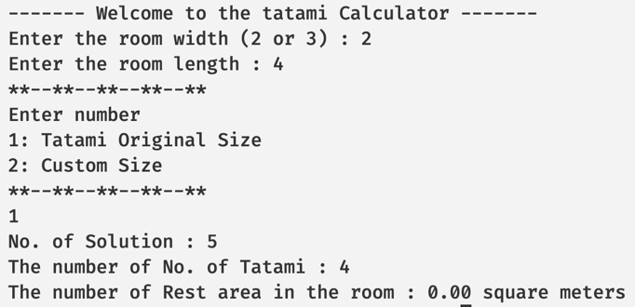
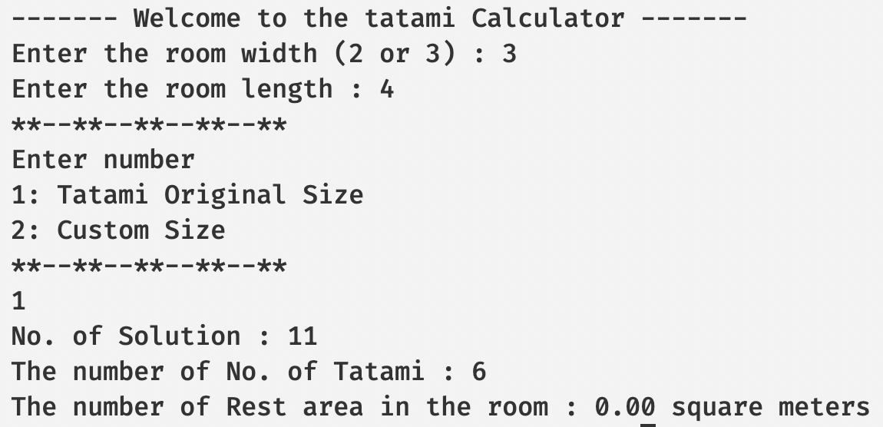
Test and result
Notes:
Our program's UI design focuses on ease of use.

Slide 18
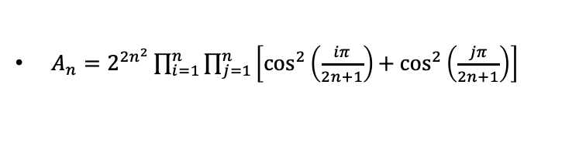
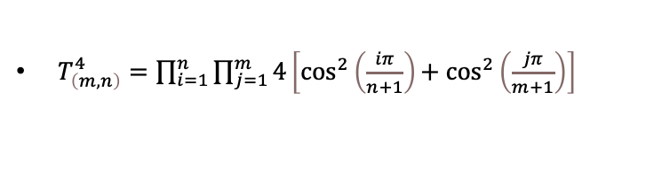
04
Conclusion
$A_{n}=2^{2n^{2}}\prod_{i=1}^{n}{\prod_{j=1}^{n}{\left[\cos^{2}\left(\frac{iπ}{2n+1}\right){+ cos}^{2}\left(\frac{jπ}{2n+1}\right)\right]}}$
$T_{\left(m,n\right)}^{4}=\prod_{i=1}^{n}{\prod_{j=1}^{m}{4\left[\cos^{2}\left(\frac{iπ}{n+1}\right){+ cos}^{2}\left(\frac{jπ}{m+1}\right)\right]}}$
list all probability counts of patterns.
Notes:
The result of the program for counting the number of tiling methods is equal to the calculation using domino tiling theorems.
$The result is the same as the output of 2 formulas below$and list all probability counts of patterns.

Slide 19
Suggestion
The cost of arranged tiles in one room can be calculated by the number of pieces of tile.
This program can be applied in industry. Example Tiles factory
This information can be used in other research studies.
This project can be used as a model or as a case study in applying mathematics to our daily life.

Slide 20
Institute: Samsenwittayalai School | Thailand
THANKS!

Slide 21
References
combinatorics - Dominos ($2 \times 1$ on $2 \times n$ and on $3 \times 2n$). (n.d.). Mathematics Stack Exchange. Retrieved April 1, 2022, from https://math.stackexchange.com/questions/1317885/dominos-2-times-1-on-2-times-n-and-on-3-times-2n
Random Domino Tilings - Wolfram Demonstrations Project. (n.d.). Demonstrations.wolfram.com. Retrieved April 2, 2022, from https://demonstrations.wolfram.com/RandomDominoTilings/
Kessler, P. (2008). Arranging Tatami Mats. https://www.mechanicaldust.com/Documents/TatamiMats_01.pdf
Ruskey, F., & Woodcock, J. (2009). Counting Fixed-Height Tatami Tilings. The Electronic Journal of Combinatorics, 16(1). https://doi.org/10.37236/215
Erickson, A., & Ruskey, F. (n.d.). Domino Tatami Covering is NP-complete. https://arxiv.org/pdf/1305.6669.pdf
Klarner, D., & Pollack, J. (1980). Domino tilings of rectangles with fixed width. https://doi.org/10.1016/0012-365X(80)90098-9
Audibert, P. (2010). Mathematics for informatics and computer science. Iste ; Hoboken, Nj.‌Borys, K. (n.d.). DOMINO TILING. Retrieved April 4, 2022, from http://math.uchicago.edu/~may/REU2015/REUPapers/Borys.pdf
Rué, J. (n.d.). Domino tilings of the Aztec Diamond. Retrieved April 5, 2022, from https://upcommons.upc.edu/bitstream/handle/2117/87721/Snapshot-2015-016.pdf
Kenyon, R. (2000). Conformal invariance of domino tiling. https://projecteuclid.org/journals/annals-of-probability/volume-28/issue-2/Conformal-invariance-of-domino-tiling/10.1214/aop/1019160260.full
‌Aamand, A., Abrahamsen, M., Ahle, T., & Rasmussen, P. (2020). Tiling with Squares and Packing Dominos in Polynomial Time. https://thomasahle.com/papers/tiling.pdf
Recursive Functions Computability and Logic. (n.d.). Retrieved April 7, 2022, from https://homepages.hass.rpi.edu/heuveb/Teaching/Logic/CompLogic/Web/Presentations/Recursive%20Functions.pdf
Alhazov1', A., Morita1, K., & Iwamoto1, C. (n.d.). A Note on Tatami Tilings. Retrieved April 9, 2022, from https://www.kurims.kyoto-u.ac.jp/~kyodo/kokyuroku/contents/pdf/1691-01.pdf
‌Kamtue, S., & Yang, B. (n.d.). DOMINO-TILING PROBLEM. Retrieved April 11, 2022, from https://math.mit.edu/research/undergraduate/spur/documents/2013Kamtue.pdf

